Slide 1
Precision Keyboard Research Application
Evaluating Gesture-Activated Precision Text Selection on iOS
NInad Govind Patil SBU ID: 116917212
Notes:
Hello everyone. My project, Precision Keyboard Research Application, explores how gesture-activated precision text selection can improve the accuracy and usability of text input on mobile devices

Slide 2
Project overview
A comprehensive iOS research application designed to evaluate the effectiveness of precision text selection methods on mobile devices. This project implements and tests "Precision Keyboard" - a novel interaction paradigm for accurate text selection on touchscreens.

Slide 3
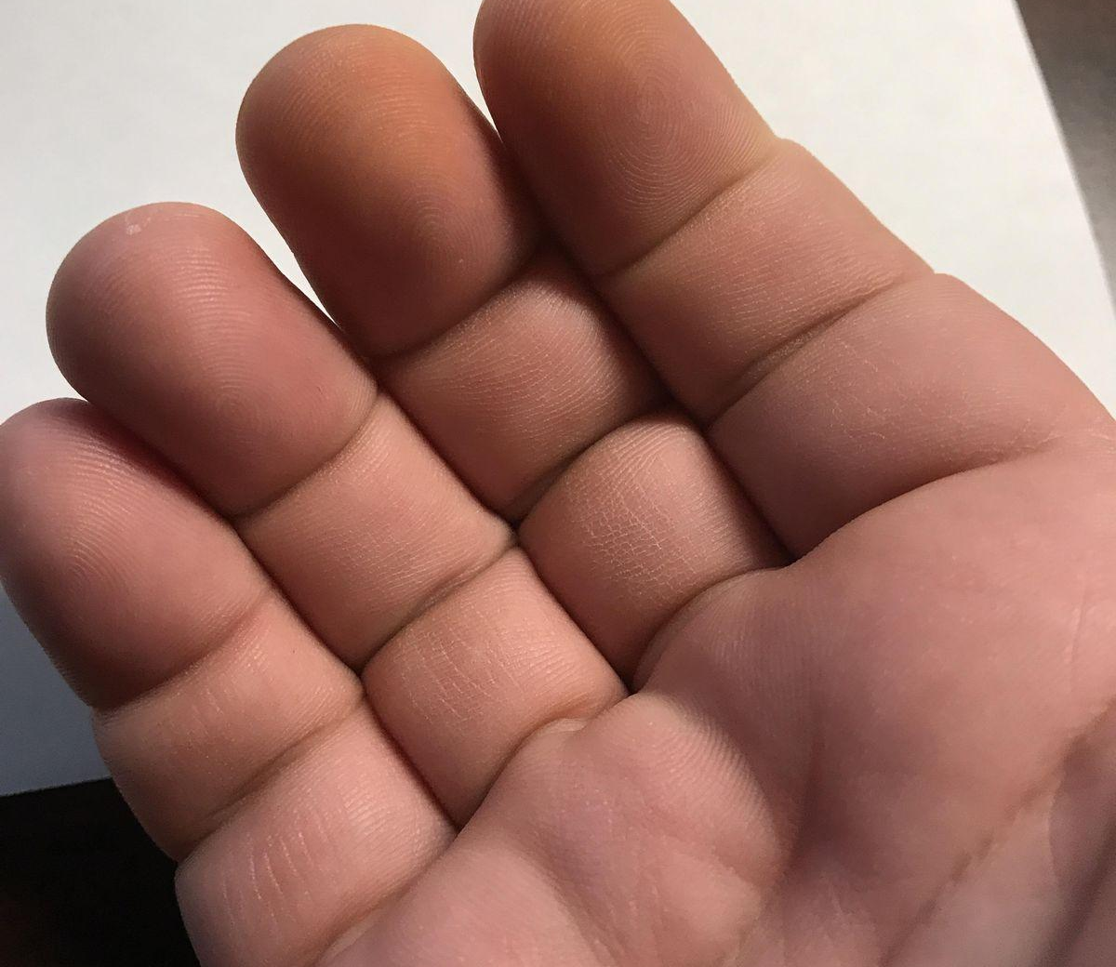
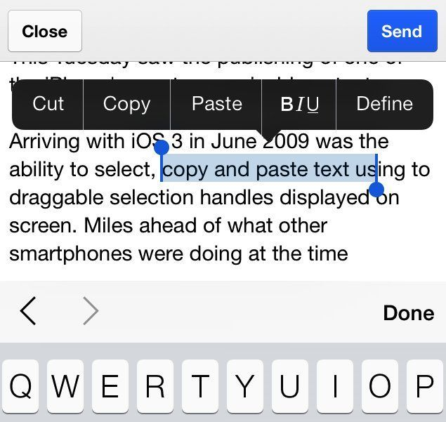
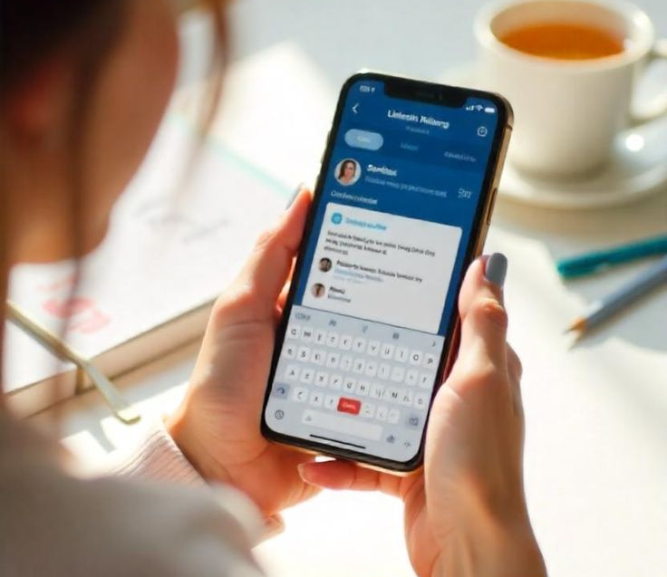
Motivation & Problem
Ninad Patil
HCI
Fall 2025
Fat Finger
Standard text handles
Natural Interaction
fingers occlude the text, reducing accuracy
Standard text handles = slow, error-prone
Need for precise yet natural interaction
Notes:
Selecting text on touchscreens is often frustrating because users’ fingers block what they’re selecting. We wanted to solve this usability issue by designing a precision mode that enhances control without disrupting natural gestures

Slide 4
Research Hypothesis
Ninad Patil
HCI
Fall 2025
Hypothesis 1
Hypothesis 2
Hypothesis 3
Higher accuracy
Faster selection
Higher satisfaction (SUS scores)
Notes:
I hypothesized that our precision mode would significantly outperform the default iOS selection in terms of speed, accuracy, and user satisfaction

Slide 5

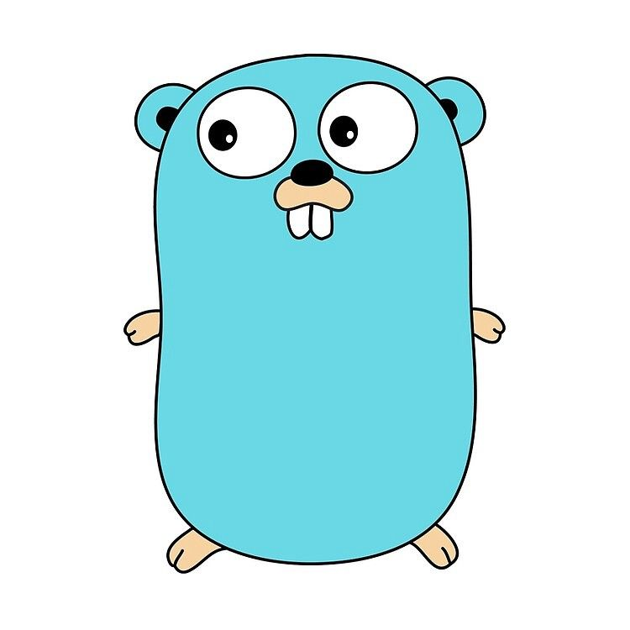
System Architecture
Ninad Patil
HCI
Fall 2025
IOS APP
Swift UI
01. iOS App: Gesture interaction, precision editor, SUS survey
02. Backend (Go): REST API, metrics logging, CSV export
Go Backend Server
03. Dashboard: Real-time visual analytics
Interactive Dashboard
Notes:
My system has three components — an iOS app for the study, a Go backend that logs data and manages sessions, and a live dashboard that visualizes participant metrics in real time.

Slide 6
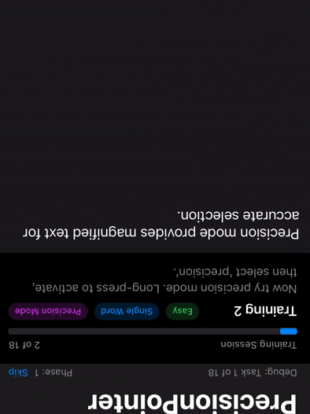
Precision Mode Design
Ninad Patil
HCI
Gesture-activated (long-press)
3× magnification of text
Persistent mode for fine adjustment
Smart exit by tapping empty space
Animated visual feedback
Notes:
When a user long-presses, PrecisionPointer magnifies the text region threefold, allowing precise movement. The mode remains active until the user taps outside, providing seamless control and instant feedback.

Slide 7
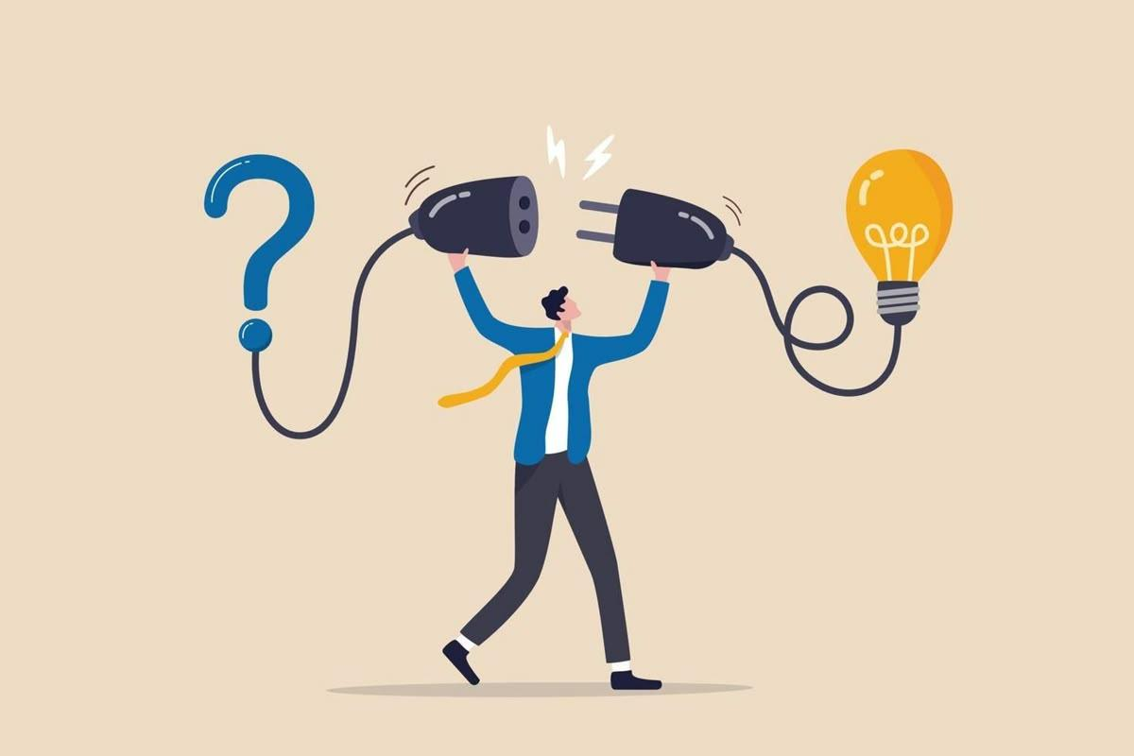



Study Design
Ninad Patil
HCI
Fall 2025
Difficulty
Participants
Counter
balancing
Task Types
Easy / Medium / Hard
All used both methods (within-subjects)
Order randomized
Single word, phrase, sentence, paragraph
Notes:
I used a within-subjects design so each participant used both techniques. Tasks varied in complexity and were randomized to avoid learning bias

Slide 8
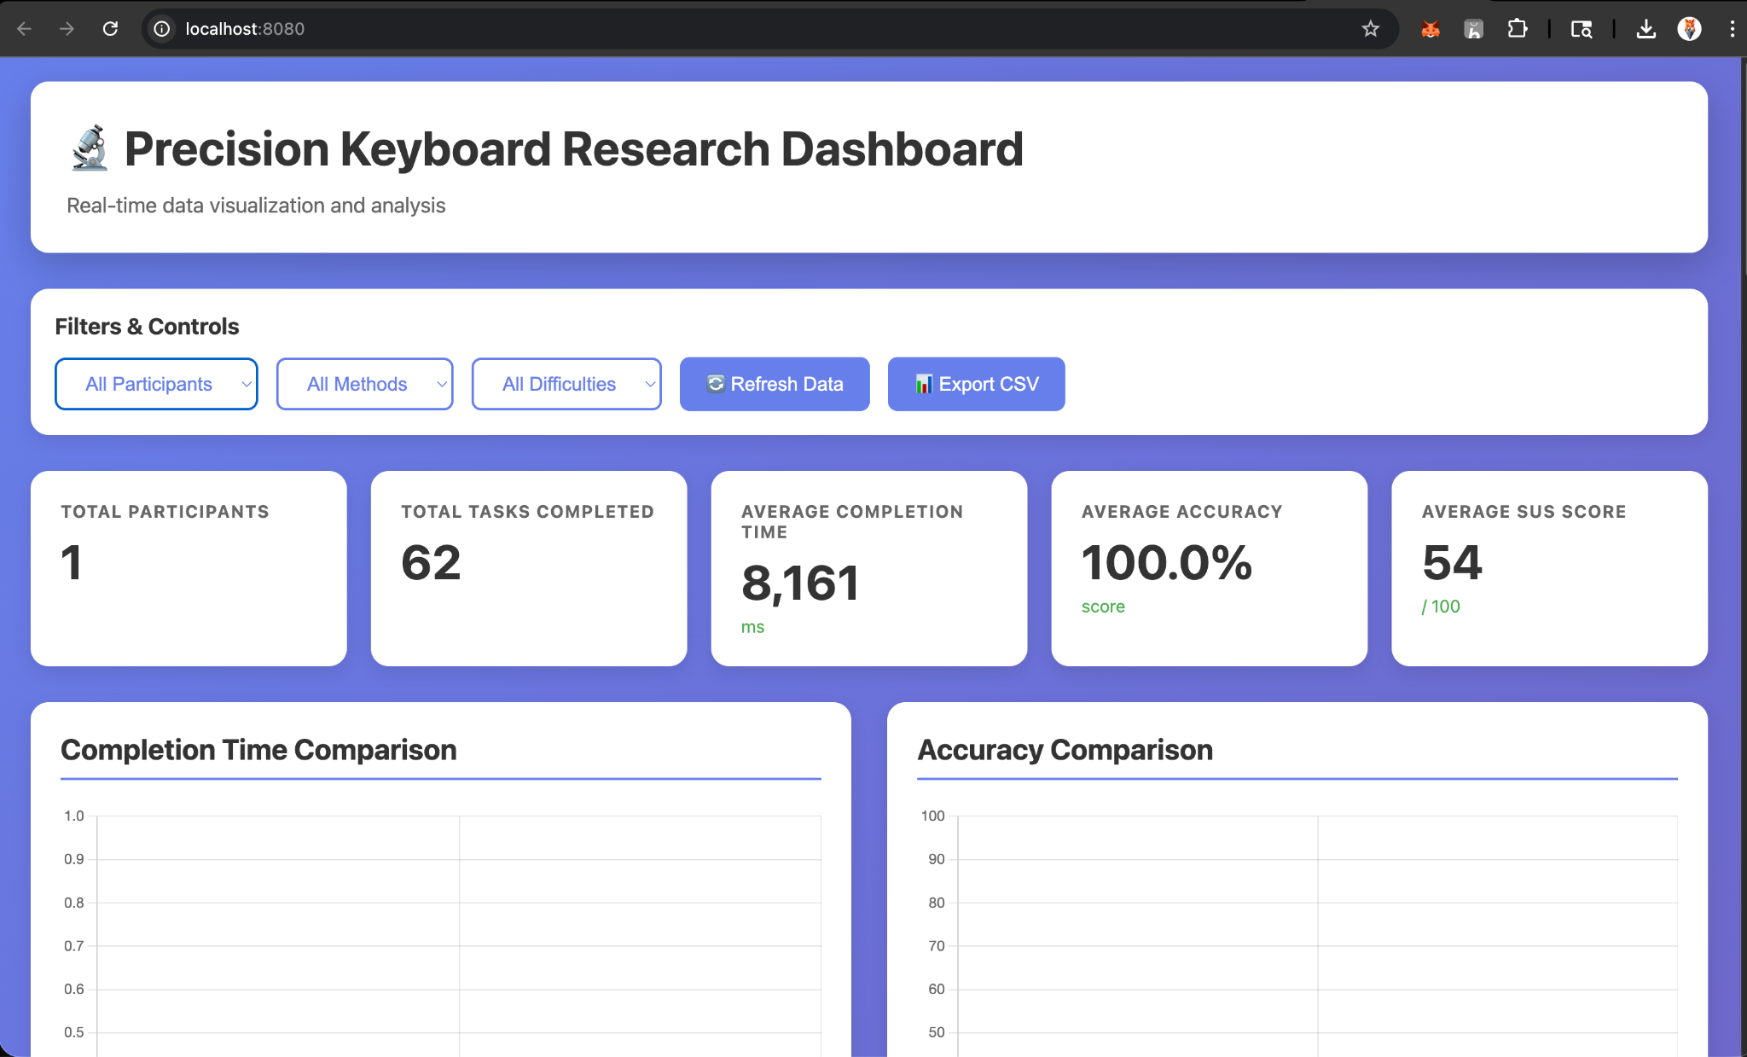
Interactive Dashboard
Ninad Patil
HCI
Fall 2025
Real-time charts: Completion time, accuracy, SUS distribution
Filters: By participant, method, or difficulty
Summary stats: Avg time, accuracy, SUS score
Auto-refresh every 30 s
Notes:
A major addition in this version is the real-time dashboard, built in Go. It visualizes performance data, tracks participants, and allows researchers to filter or export results directly from the browser.

Slide 9
Research Methodology
Ninad Patil
HCI
Fall 2025
Within-Subjects design
Training → Main Tasks → SUS survey
Statistical analysis methods:
Paired t-tests
ANOVA (task type × difficulty)
Correlation & effect size
Notes:
I followed a structured study flow: a short training phase, the main task sequence, and then the SUS survey. The results were analyzed statistically using paired t-tests and ANOVA

Slide 10

Expected / Preliminary Results
Ninad Patil
HCI
Precision mode:
Faster average completion time
Fewer errors
Higher SUS satisfaction
Graph mockup (bar chart: speed, accuracy, satisfaction ↑)
Notes:
Preliminary analysis shows promising improvements — higher accuracy and faster completion times with PrecisionPointer, and users preferred it overall.

Slide 11
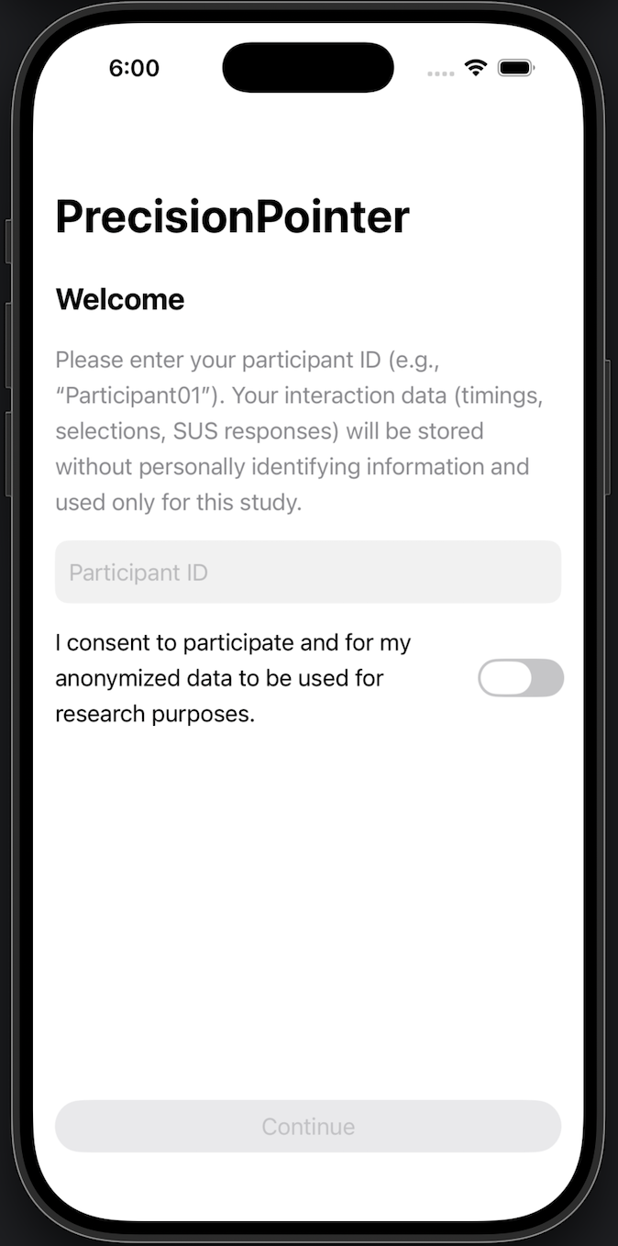
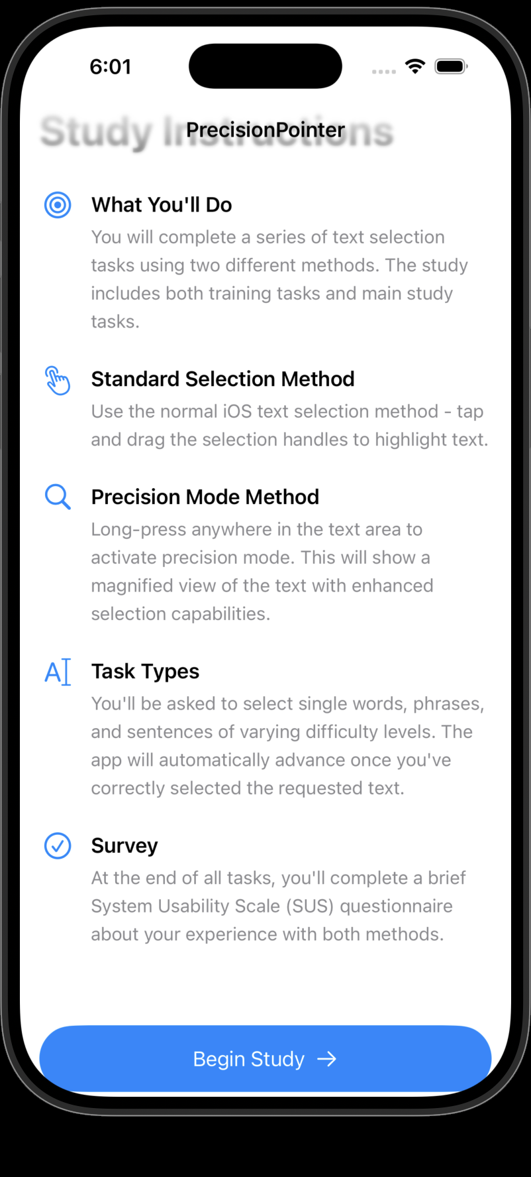
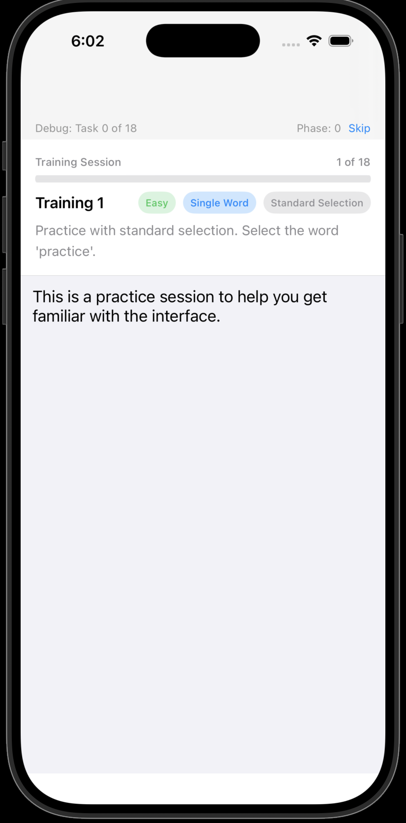
Company Name
Quarter
Month Year

Slide 12
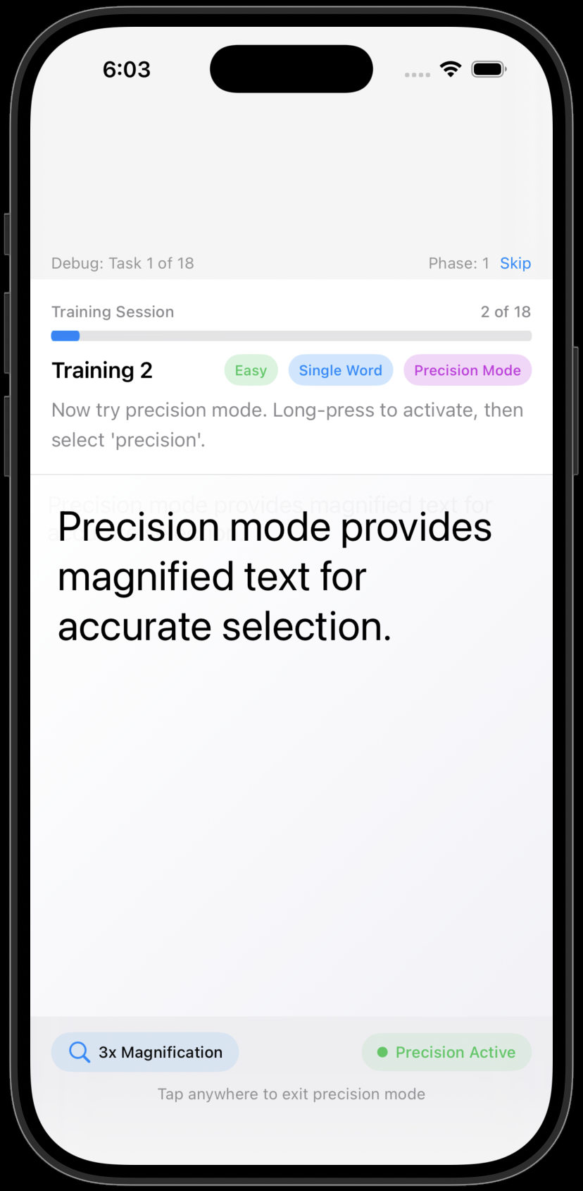
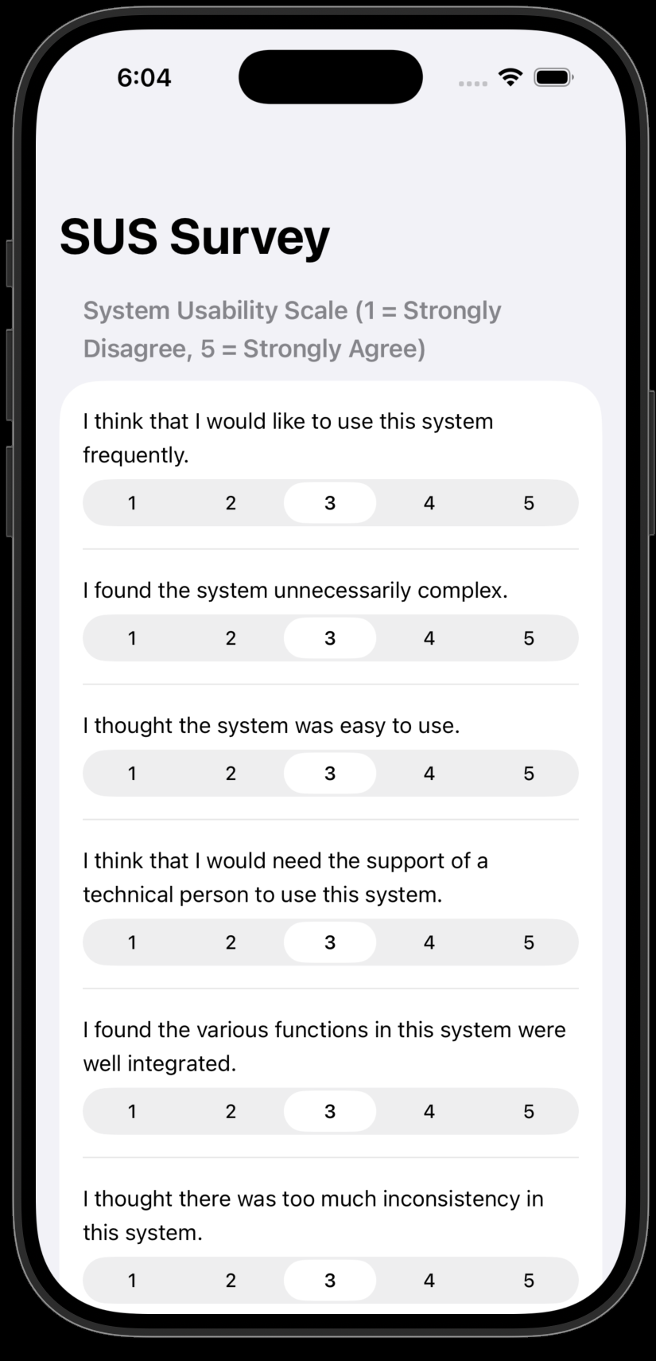
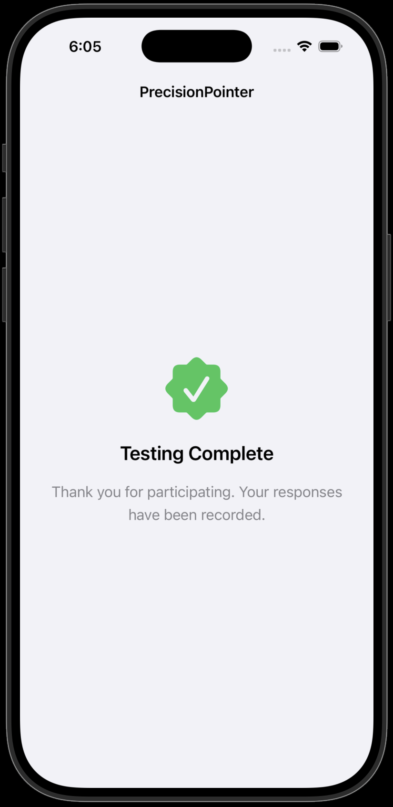
Company Name
Quarter
Month Year

Slide 13

Thank you
Ninad Patil
HCI
Fall 2025
: https://github.com/ninadpatil1452/Precision-Keyboard
Notes:
In conclusion, PrecisionPointer demonstrates how thoughtful interaction design can significantly improve precision and satisfaction in everyday touch interactions

